Slide 1
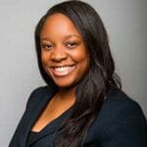
Mitigating and Responding to Bias in your Title IX Process
Jeanine Bias-Nelson
Director, Office of Equity and Inclusion/Title IX Coordinator
Sam Houston State University
Jeanine.bias@gmail.com

Slide 2
After participating, you will be able to identify and mitigate your personal bias during your Title IX process.

Slide 3
Section 1: Defining Bias
What bias is and is not
Self Awareness
Section 2: Recognizing Bias
How it appears in your Title IX process
Evaluate a Title IX scenario
Section 3: Responding to and Mitigating Bias
How to respond to and mitigate bias before, during and after the critical steps of your Title IX process
Tips and Best Practices
Reducing the Culture around Bias

Slide 4
Defining Bias
1

Slide 5
Final Rule Requirements Regarding Bias
Regulations require no bias or conflicts of interest:
§ 106.45(a) provides: An IHE’s treatment of a complainant or a respondent in response to a formal complaint of sexual harassment may constitute discrimination on the basis of sex under Title IX.
§ 106.45(b)(1)(iii) provides: any individual designated by an IHE as a Title IX Coordinator, investigator, decisionmaker, or any person designated by an IHE to facilitate an informal resolution process, cannot have a conflict of interest or bias for or against complainants or respondents generally or an individual complainant or respondent.
§106.45(b)(1)(iii) further provides: that all Title IX Coordinators investigators, decision-makers, and any person who facilitates an informal resolution process, must receive training on how to serve impartially, including by avoiding prejudgment of the facts at issue, conflicts of interest, and bias. In conducting Title IX proceedings, all such persons must not rely on sex stereotypes—typical notions of what men or women do or do not do—and must promote impartial investigations and adjudications of formal complaints of sexual harassment.
Note – However, the regulations do not provide a definition for conflicts of interest, bias or impartiality

Slide 6
Icebreaker

Slide 7


What is the safer method of transport?
OR

Slide 8


What are you most afraid of?
OR
OR

Slide 9
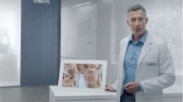
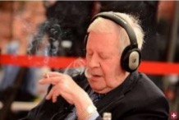
Who is more competent?
OR

Slide 10
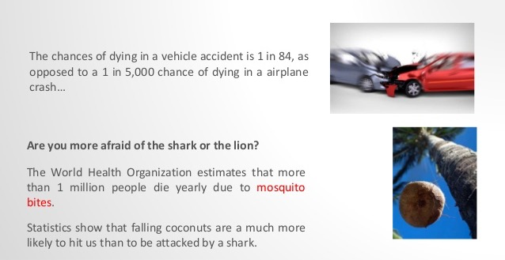
Does this information change your mind?

Slide 11
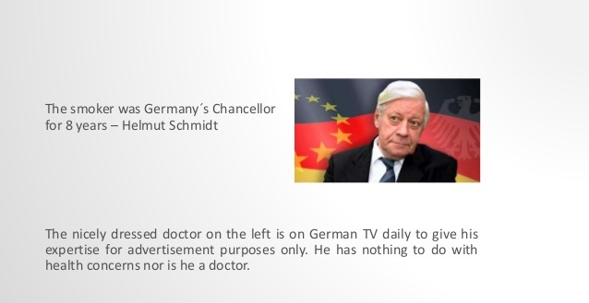
Does this information change your mind?

Slide 12
Guiding Principles
Bias IS NOT Bad – what you do based on bias could potentially be harmful.
01
Being different and recognizing differences is “okay.”
02
Our view of the world (worldview) is shaped by values, perceptions, assumptions and expectations.
03

Slide 13
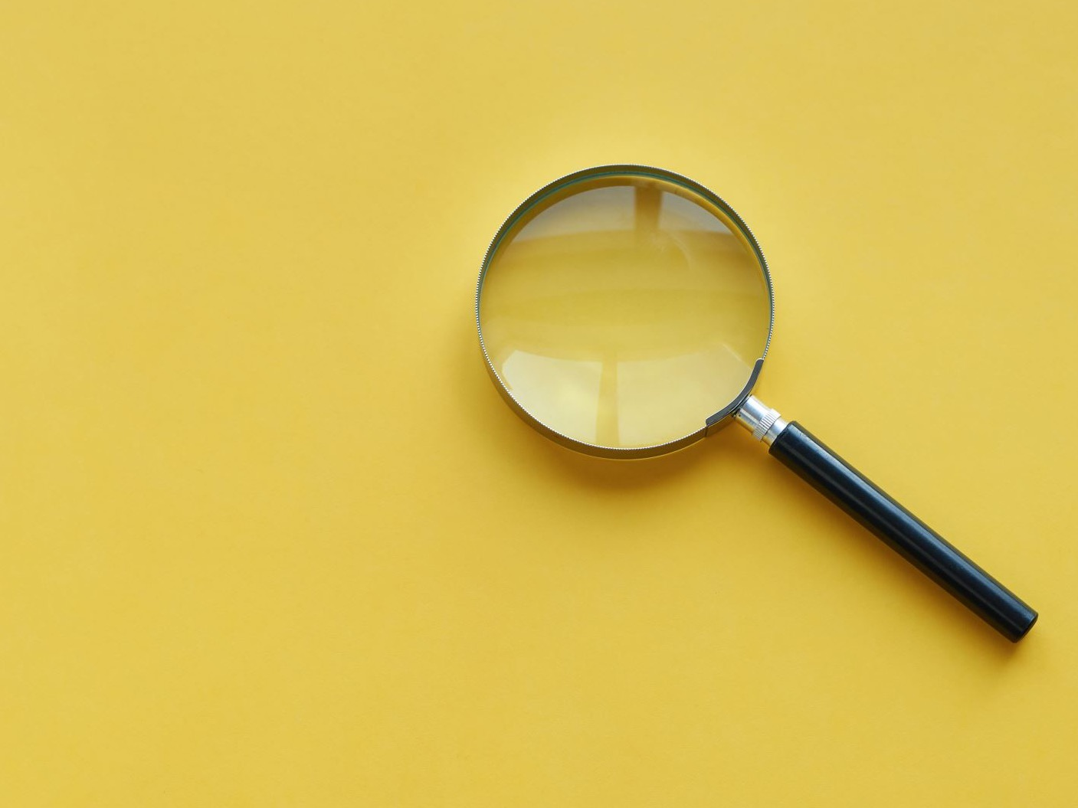
Are you biased? I am.
13
Notes:
Jeanine

Slide 14

Jumpstarting Our
Understanding of Biases
Define: What are biases? What types of bias exist?
Recognize: Where do my biases come from? How do they influence my actions and the actions of groups I identify with?
Overcome: What can we do about them? Individually? As Interviewers?
14

Slide 15

B.I.A.S
Beliefs
Ideas
Assumptions
Stories
15

Slide 16
Defining Bias
There are 2 forms of biases:
Conscious bias (also known as explicit bias) and
Unconscious bias (also known as implicit bias)
It is important to note that biases, conscious or unconscious, are not limited to ethnicity and race. Though racial bias and discrimination are well documented, biases may exist toward any social group. One’s age, gender, gender identity physical abilities, religion, sexual orientation, weight, and many other characteristics are subject to bias.
16

Slide 17
Being of Two Minds
Our mind operates in both conscious and unconscious modes
Human beings can think, feel and behave in ways that run counter to their explicitly held and expressed views
Reflective system for controlled processing
  Conscious, explicit
  Effortful, requires motivation
  Takes more time
Reflexive system for automatic processing
  Often unconscious, implicit
  Requires little effort
  Fast

Slide 18
Recognizing Bias
2

Slide 19
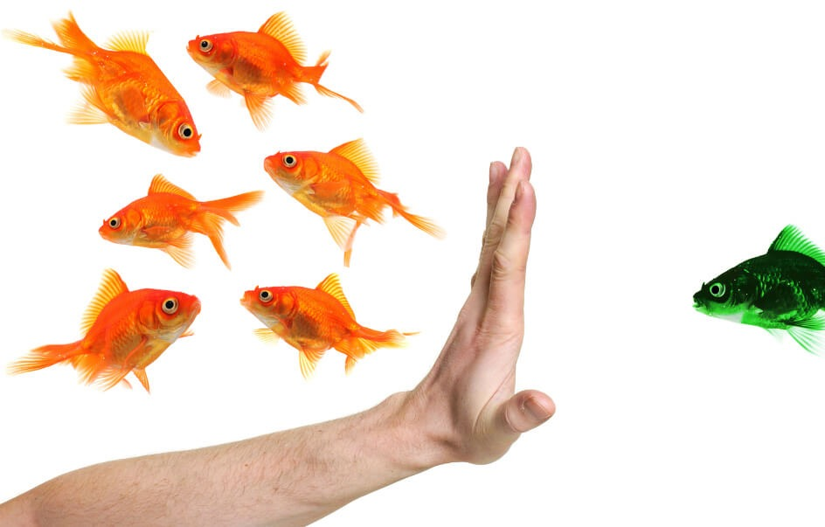
19

Slide 20
Identifying Potential Bias

Slide 21
Common Bias in Title IX Process
Affinity Bias
Anchoring Bias
Halo Effect
Confirmation Bias
Priming
Authority Bias

Slide 22
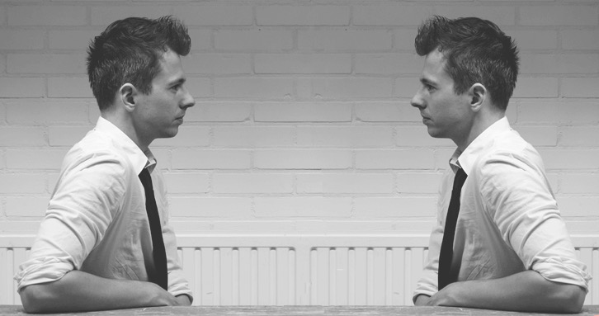
Affinity Bias
Affinity bias is the unconscious tendency to get along with others who are like us
22

Slide 23
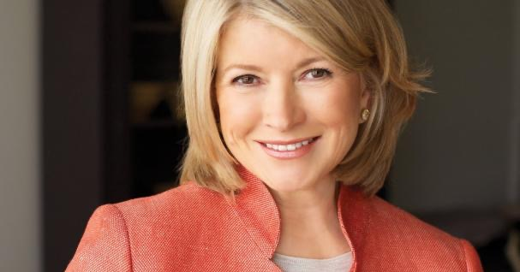
TV Star…

Slide 24
Or Criminal…

Slide 25
Anchoring Bias
Fixate on initial information and fail to adjust for subsequent information.
This also happens when we are blinded by first impressions or influenced by first impressions, ideas, prices, or estimates relative to info received later.
25

Slide 26

Halo Effect
The halo effect occurs when an initial positive judgment about a person unconsciously colors the perception of the individual as a whole.

Slide 27
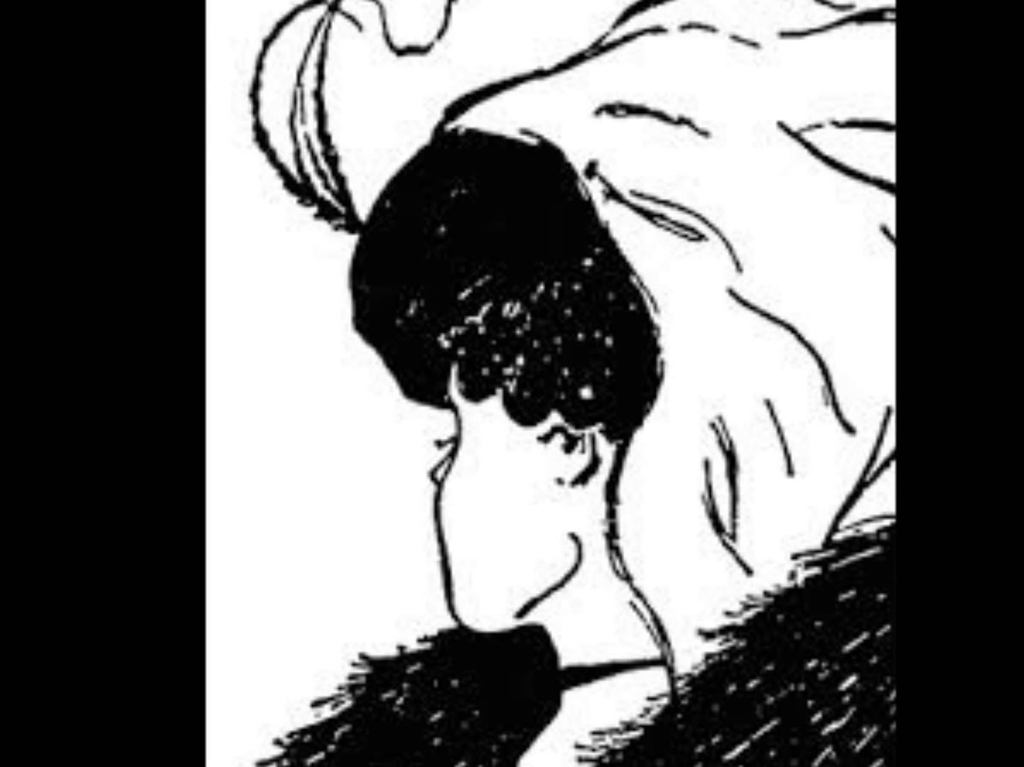
27

Slide 28
Confirmation Bias
Form of Selective Perception
See things from our own personal perspective
Organize and interpret events/information based on this perception
Influences what we pay attention to and the problems we identify, and the alternatives we develop or consider.

Slide 29
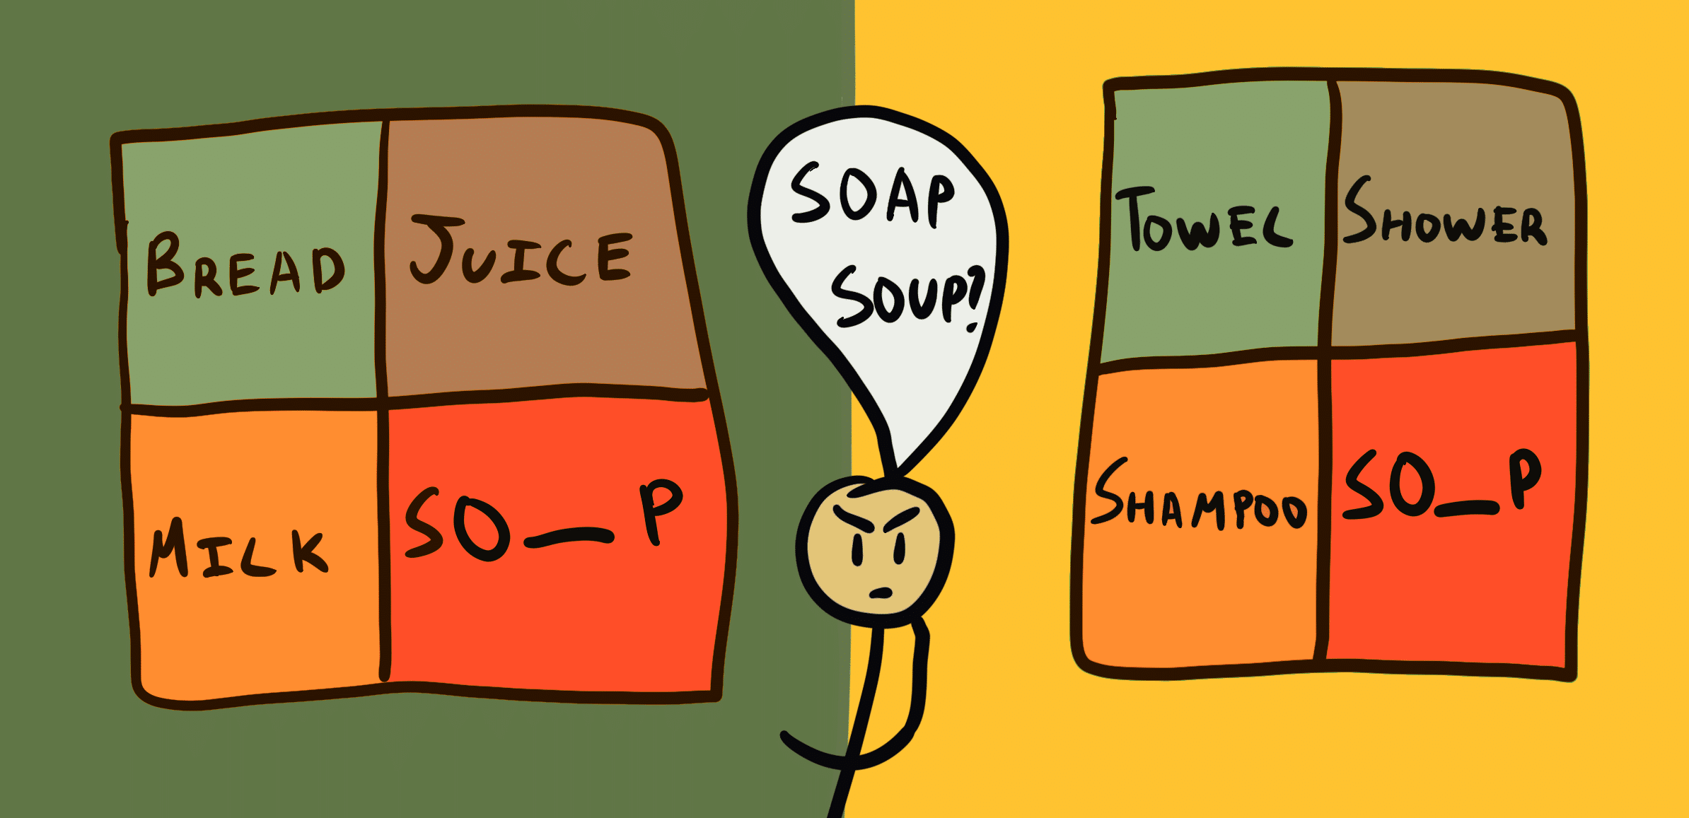
Priming Effect
Priming, or, the Priming Effect, occurs when an individual’s exposure to a certain stimulus influences his or her response to a subsequent stimulus, without any awareness of the connection. These stimuli are often related to words or images that people see during their day-to-day lives.
29

Slide 30
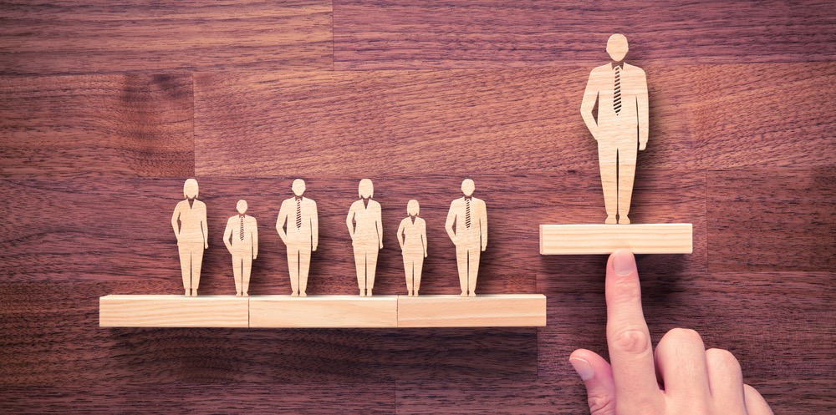
Authority Bias
It is the tendency to attribute greater accuracy to the opinion of an authority figure (unrelated to its content) and be more influenced by that opinion
30

Slide 31
Evaluate the Scenario

Slide 32
Responding to and
Mitigating Bias
3

Slide 33

Responding to Bias Under in Specific Roles
Bias of Investigator
Bias of the Interviewee
Bias during a Live Hearing
Bias of the Title IX Coordinator/ Process
33

Slide 34
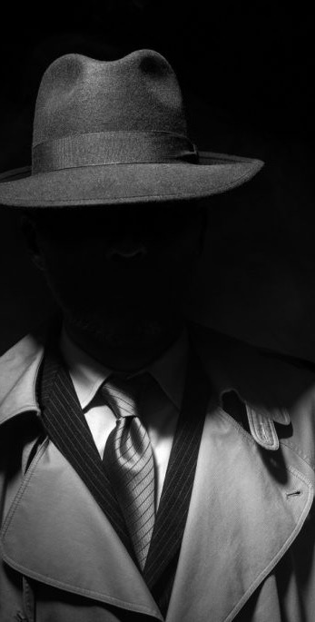
Mitigating Investigator Bias
Pre-planning
Checks and balances/ accountability partner
Avoid pre judgement
Impartiality
Let the investigation lead you not the other way around
Notice trends
Assess your process from beginning to end
34

Slide 35
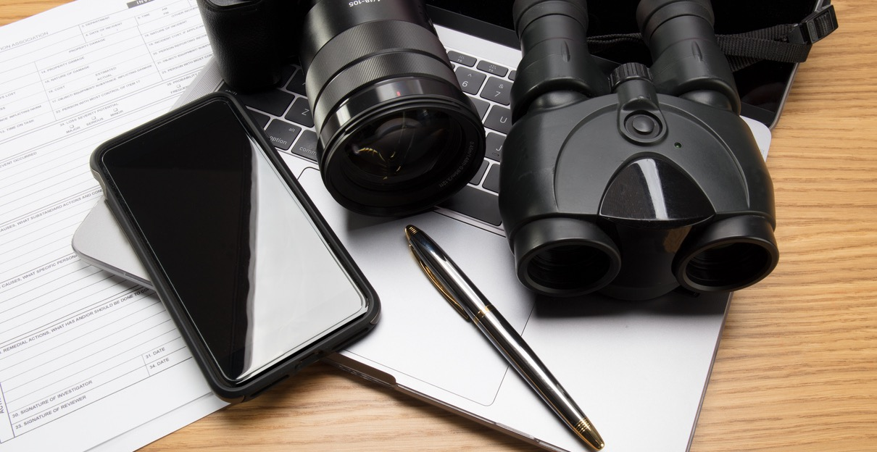
Specific Implications of Bias for Investigators
Interview Report Writing

Slide 36
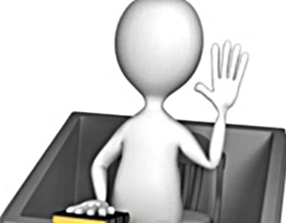
Responding to Interview Bias
Prompt Scheduling
Rapport Building
Consistency
Questioning

Slide 37
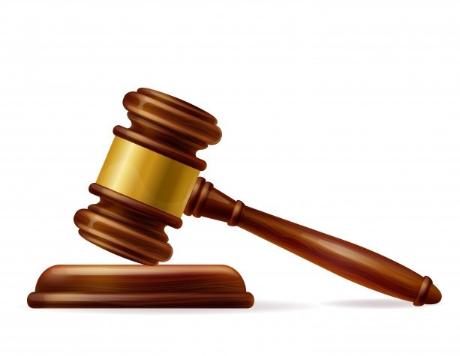
Specific Implications of Bias for Decision Makers
Notice Your Reaction
Review all information before the hearing
Presence of the Advisor
Authority Bias and Group Think
Appeals

Slide 38

Impartiality
Training and Presentations
Perceptions
Reputation
Specific Implications of Bias for Title IX Coordinator/ Process

Slide 39
Best Practices in Mitigating Bias
Avoid Stereotypes
Appearence of Bias vs Actual Bias
Show Your Work
Be Thorough

Slide 40
Best Practices in Mitigating Bias
Separating intake from investigation
Pre-investigation checklist
Investigation Meetings with Title IX Coordinator/other staff
Evaluation of Title IX Team
Evaluation of Title IX Process

